Slide 1
Government of Bihar Road Construction Department
Presentation of
Online Monitoring of different projects
through
Project Management Information System
executed by the
NIC

Slide 2
Project Management Information System
http://onlineapp.bih.nic.in/RCDPMIS/Login.aspx

Slide 3
LOGIN

Slide 4
HOME SCREEN

Slide 5
PROJECT ENTRY

Slide 6
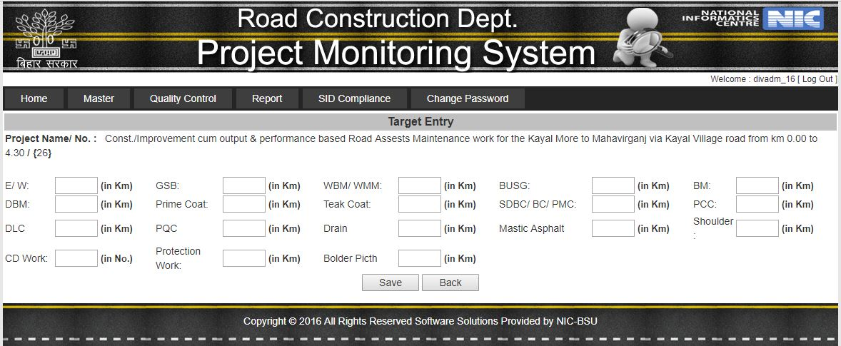
TARGET ENTRY

Slide 7
Other Target Entries

Slide 8
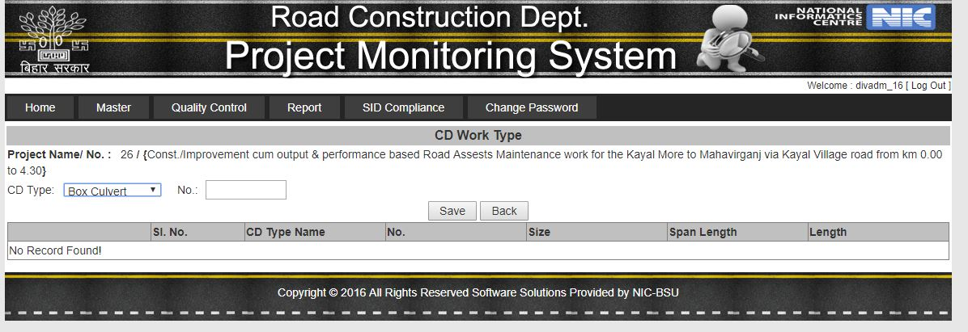
CD Work Type

Slide 9
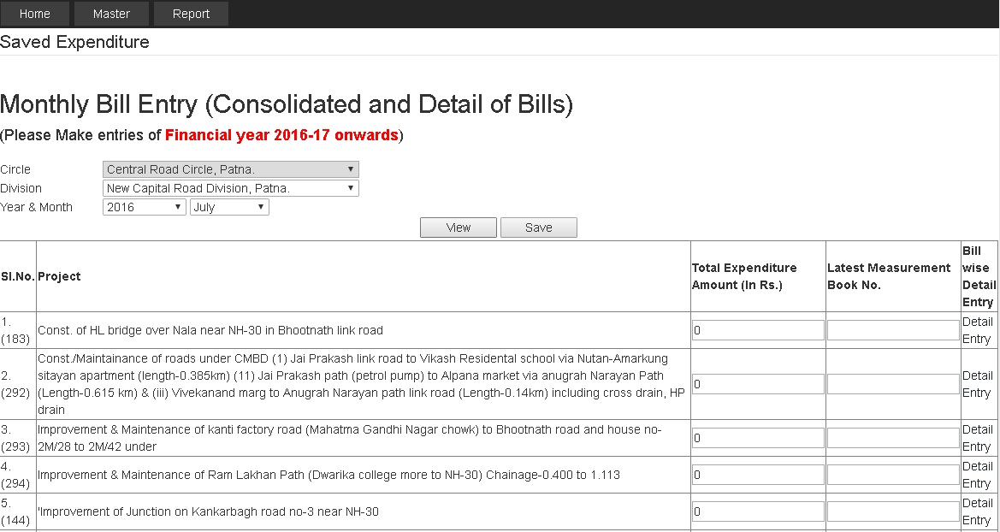
BILL ENTRY

Slide 11
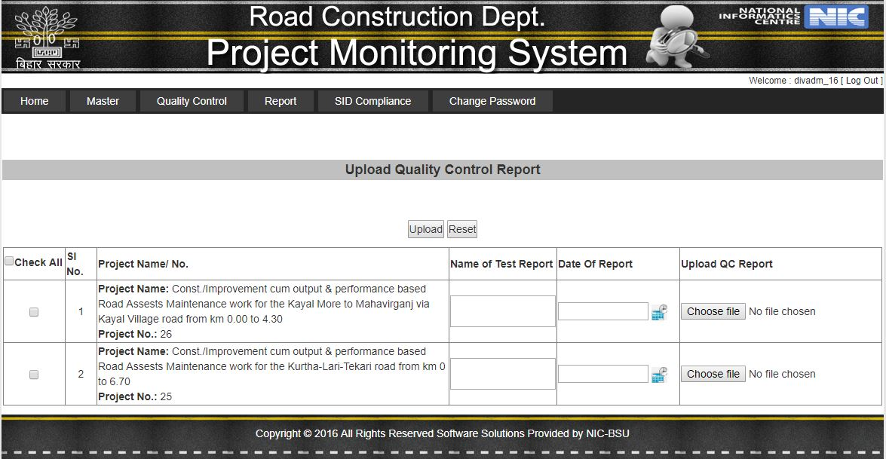
Upload QC Report

Slide 12
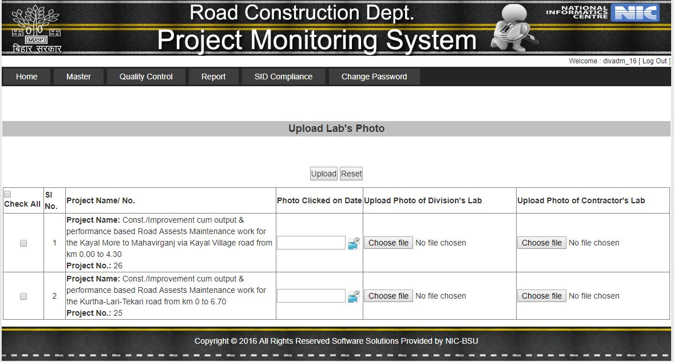
Upload Lab’s Photo

Slide 13
Progress Report

Slide 14
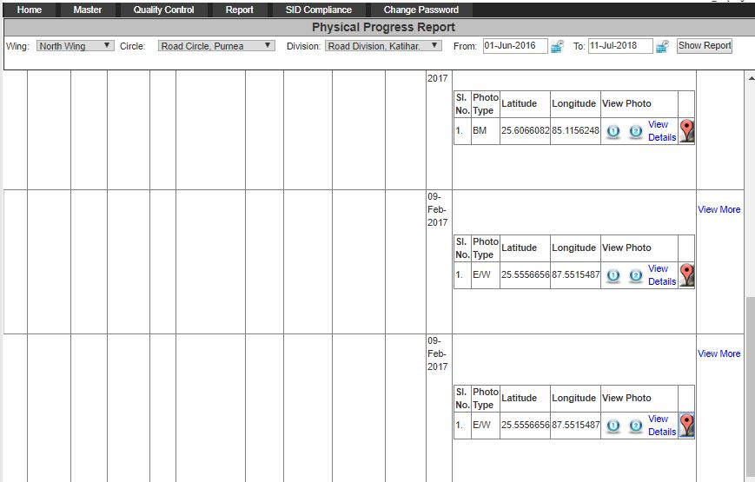
Physical Progress Report

Slide 15
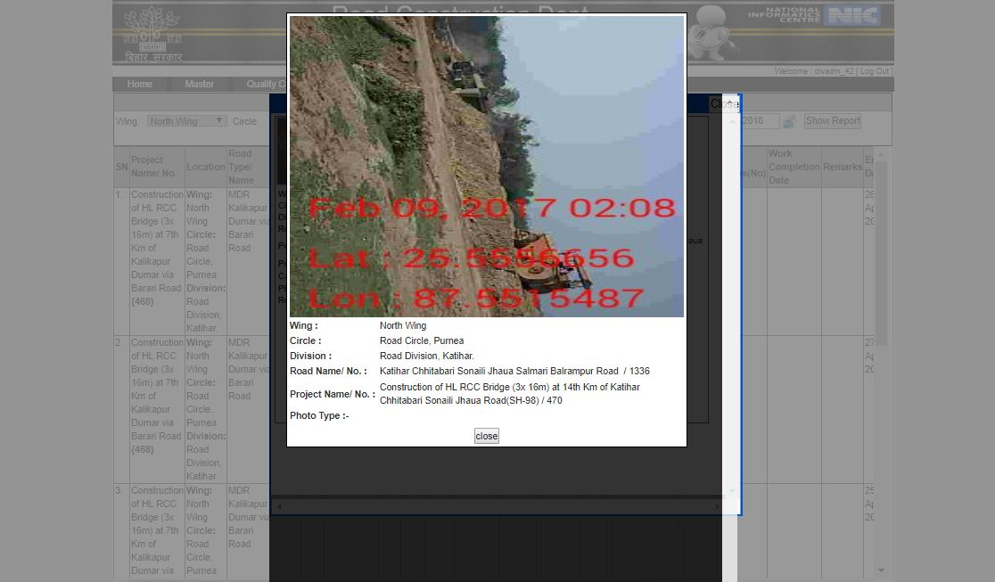
View Photo

Slide 16
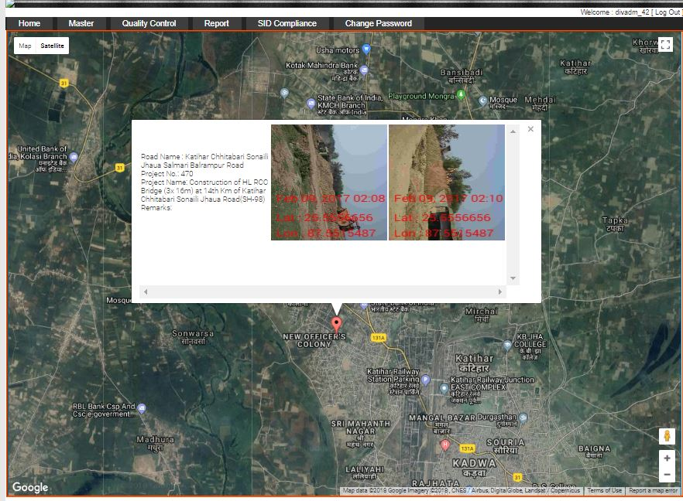
View Photo

Slide 17
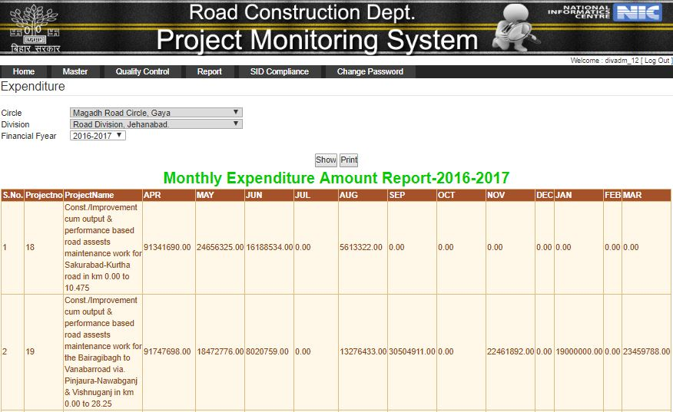
Month wise Expenditure Report

Slide 18
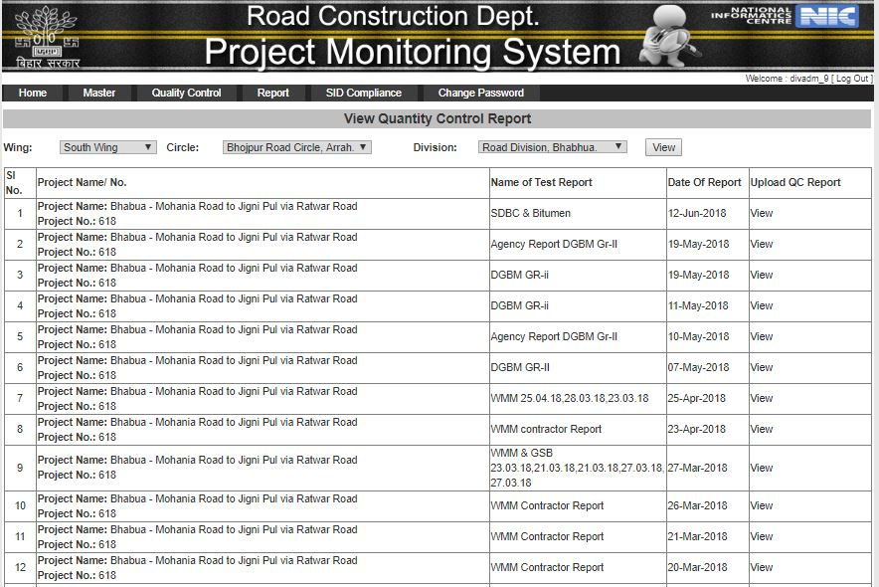
View QC Report

Slide 19
Thank You

